Slide 1



Maven & Gradle Tutorial
Yannis Marketakis
FORTH-ICS

Slide 2
Outline
Maven
Introduction
X-Ray of a Maven project
The POM
Working with Maven
Gradle
Introduction
Working with Gradle
Gradle vs others

Slide 3
Apache Maven
It was born in 2002 as a subproject of Apache Turbine
Developed and maintained
Apache Software Foundation
Licensed
Apache License 2.0
Major releases
Maven 1: July 2004
Maven 2: October 2005
Maven 3: October 2010

Slide 4
Apache Maven
Apache Maven is a software project management tool for JAVA projects
It manages
Building
Testing
Reporting
Production of documentation
Releasing
Input: source code & resources
Output: compiled and packaged code (i.e. jar), documentation, etc.

Slide 5


Life B.M. (Before Maven) – javac, java
000101010101010101010101
.java
.class
000101010101010101010101
.class
.java
.java
000101010101010101010101
000101010101010101010101
.class
.class
.java
.java
000101010101010101010101
.class
.java
javac –cp
<jars>
<files>
java –cp
<jars>
<files>

Slide 6

Life B.M. (Before Maven) – Apache Ant
Developed by Apache
Offers software build automation
Similar to make, for Java projects
Supports
Compiling, Assembling, Testing, Running Java applications
Configuration and extensions
Uses XML syntax
build.xml

Slide 7
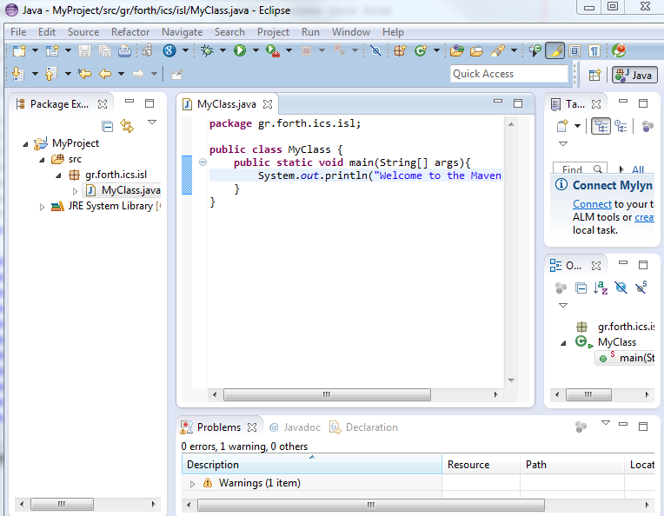
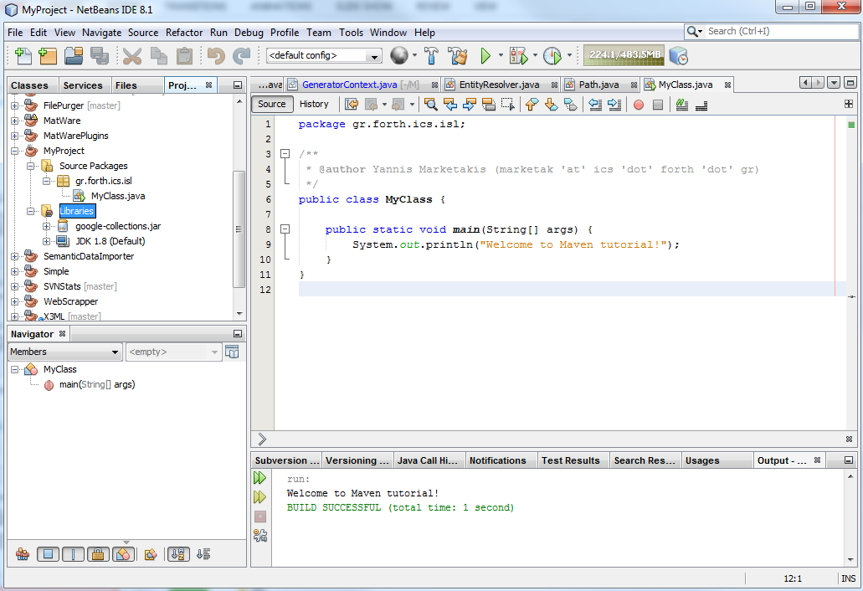
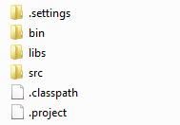
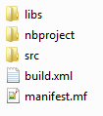
Life B.M. (Before Maven) - IDEs

Slide 8




The Maven way
.java
.java
.java
.java
sources
.java
.java
resources
configuration
file

Slide 9
The Maven way
Write your source code
Provide your resource files (i.e. log4j.properties, beans.xml, etc.)
Declare the dependencies of your source code
Define your output (jar, war, manifest files, etc.)
Write your tests
Clean, Build, Test, Run

Slide 10

The ClassNotFoundException
B
C
A
D
MyProject
E
F
Building: ✓
Running: ✗

Slide 11
Maven Dependencies
Process
Declare the direct dependencies of MyProject (and their version)
A.jar
Maven is responsible for (transitively) resolving and downloading the indirect dependencies of MyProject
B.jar, C.Jar, D.jar, E.jar, F.jar
Advantages:
No need to download dependencies beforehand → less size, less duplicates, enhanced expressivity
Ensures compilability, testability & runability

Slide 12
X-Ray of a maven project
MyProject (ordinary)
src
test
libs (some MBs)
build.xml
dist
MyProject (maven)
src
pom.xml
target
Project | Ordinary | Maven
X3ML | 17 MBs | 4 MBs
MatWare | 34 MBs | 0.4 MBs
XSearch | 35 MBs | 1.7 MBs
LifeWatch DataServices | 38 MB | 2.3 MBs

Slide 13
X-Ray of a maven project – cont’d
MyProject
src
main
java
resources
test
java
resources
pom.xml
target
java: for adding source code (i.e. java files
resources: for adding resource files that will be included in the final artifact (jar/war)
main: for adding main source code and resource files
test: for adding source code and resource files for tests
target: compiled code and produced artifacts
pom.xml: the POM !

Slide 14
Maven POM
POM stands for Project Object Model
XML representation of the project
The POM contains:
Identification of the project
Credits and more information (i.e. CVS, tracking system)
Licensing information
Dependencies of the project
Plugins for producing various artifacts (i.e. jars, exejars, zip files, etc.)

Slide 15
Maven POM – Maven Coordinates
<groupId> gr.forth.ics.isl </groupId>
<artifactId> MyProject </artifactId>
<version> 1.0 </version>
The identity of the project / artifact
groupId: identification of the project/category of projects
com.google.common , gr.forth.ics.isl , eu.lifewatch
artifactId: the name of the jar/war
google.collections , matware , data-services-api
version: the (numerical) version of the project
1.0 , 2.0.3 , 1.0-rc1
packaging: (optional) the artifact type
jar , war

Slide 16
Maven POM – Maven Coordinates
Credits and more information
Information about the owner of the source code, the developers (names, e-mails, etc.)
Information about the projects mailing lists
SCM (Software Configuration Management) information
Information about issue management, CI management, etc.
<organization>
<name> Institute… </name>
<url> http://www. </url>
</organization>
<developers>
<developer> … </developer>
</developers>
<mailingLists> … </mailingLists>
<scm>
<connection> … </connection>
<developerConnnection> …
</developerConnction>
</scm>

Slide 17
Maven POM – Maven Coordinates
Plugins
Every task in maven is done by plugins (i.e. create jar, unit testing, documentation, etc.)
Two types:
Build and Reporting plugins
Common plugins:
clean, compiler, Javadoc, jar, war, surefire, etc.
<plugin>
<groupId> … </groupId>
<artifactId> … </artifactId>
<version> … </version>
<configuration> … </configuration>
<executions> … </executions>
…
</plugin>

Slide 18
Maven POM – Maven Coordinates
Dependencies
The artifacts that a project directly depends on
Mandatory fields
groupId, artifactId, version
Optional fields
Type, scope, optional
<dependency>
<groupId> log4j </groupId>
<artifactId> log4j </artifactId>
<version> 1.2.16 </version>
</dependency>
<dependency>
<groupId> org.jooq </groupId>
<artifactId> joox </artifactId>
<version> 1.2.0 </version>
<type> jar </type>
<scope> test </scope>
<optional> true </optional>
</dependency>

Slide 19
Maven POM – Maven Coordinates
By default every POM inherit from a parent POM
The base POM (that by default inherit all POMs) is called Super POM
Offers the main functionalities (although they can be easily overridden)
Allows the user to specify the minimum configuration details in their pom
Developers can also inherit different POM
They are declared as parent POMs

Slide 20
How it works
A
MyProject
B

Slide 21
How it works – Maven repositories
Local Repository
In the developer’s system. Created automatically and stores downloaded dependencies and compiled artifacts
Maven Central Repository
A public repository offered by the Maven community.
Remote Repositories
Third-party repositories

Slide 22
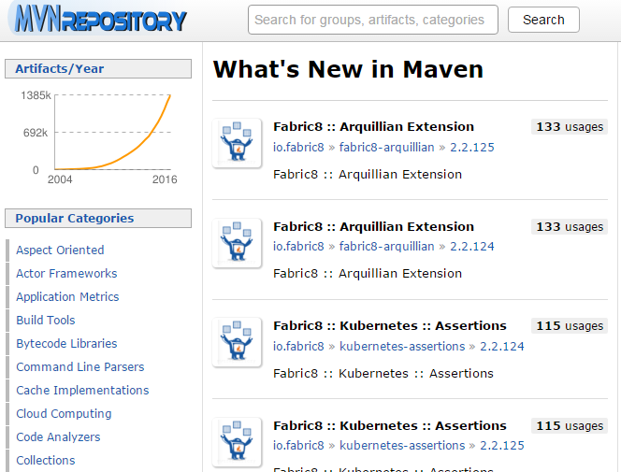
How it works – Maven repositories
A registry of libraries
Found at http://mvnrepository.com/
Default repository to search for libraries

Slide 23
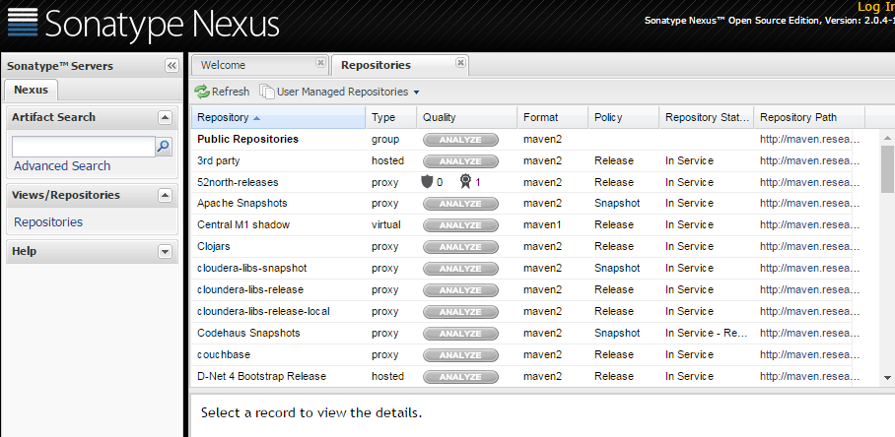
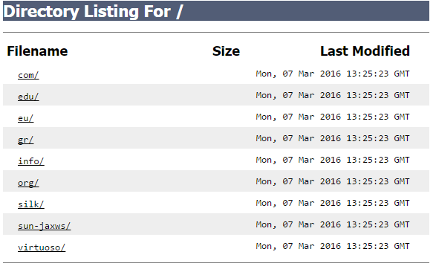
How it works – Maven repositories

Slide 24
Maven POM – Maven Repositories
Remote repositories are declared in the POM
Dependencies are resolved against maven central repository and the declared remote maven repositories
<repositories>
<repository>
<id> FORTH-ICS-ISL-maven </id>
<name> FORTH-ICS-ISL maven repository </name>
<url> http://www.ics.forth.gr/isl/maven </url>
</repository>
</repositories>

Slide 25
How it works – Maven repositories
Dependency search sequence
Search for a dependency in the local repository
If not found, search a dependency in the maven central repository
If not found and remote repositories exist, search in remote repositories
If not found, declare that the dependency cannot be resolved

Slide 26



How it works – Maven repositories
Maven
central
repository
search
dependencies
mvn
compile/run/test
search
dependencies
Remote
repositories
local
repository
store
dependencies

Slide 27
How it works – Maven repositories
Once a (released) artifact has been download in the local repository it will not be fetched again
No need for internet connection to build/run/test
Time: slow for the first time, quick afterwards
Avoids the replication of similar artifacts
Location of the local maven repository
Windows: C:/users/username/.m2/repository
Linux: ~/.m2/repository

Slide 28



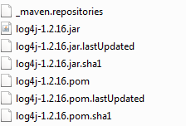
How it works – Maven repositories
<groupId> log4j </groupId>
<artifactId> log4j </artifactId>
<version> 1.2.16 </version>

Slide 29
How it works – installing artifacts
I want to use a jar but I cannot find it in maven central or a remote repository
Install it
mvn install:install-file – Dfile=myProj.jar -DgroupId=myGroup -DartifactId=myArtifact -Dversion=1 -Dpackaging=jar
Declare the above dependency in the POM
Use it

Slide 30
Maven – Developing new things
MyProject uses some functionalities from a.jar which is under development (not released yet)
The traditional way
Do you have the new features of a.jar?
Yes
Can you send me the new jar ?
Sure! I’m sending it.
myProject. jar
a.jar
I’m deleting the old one
I’m using the new one

Slide 31
Maven – Developing new things
MyProject uses some functionalities from a.jar which is under development (not released yet)
The Maven way
Developing new
features for a
myProject. jar
I’m using the new features
a.jar

Slide 32
Maven – Developing new things
Artifacts under development are annotated as SNAPSHOT versions
Inform developers that the artifact is not a final release, but an artifact under development (not guaranteed functionalities)
Instructs maven to check for updated versions in remote repositories (even if the artifact) exists in the local repository
By default it searches for new SNAPSHOT artifacts every day
Other Options (always, interval in minutes, never)
<groupId> gr.forth.ics.isl </groupId>
<artifactId> MyProject </artifactId>
<version> 1.0-SNAPSHOT </version>

Slide 33
The settings.xml file
It is a reference for defining user-specific configurations for Maven
It is not mandatory
Location of the settings.xml
Windows: C:/users/username/.m2/settings.xml
Linux: ~/.m2/settings.xml
Configures maven in terms of
SNAPSHOT update policy, proxy servers, public repositories, etc.

Slide 34
The Build Lifecycle
Maven is based around the concept of the build lifecycle
Build-in build lifecycles:
Default
Handles the project deployment
Clean
Handles the project cleaning
Site
Handles the creation of the documentation of the project

Slide 35
The Build Lifecycle - Phases
Every build lifecycle consists of phases
Each phase is just a stage in the lifecycle
Default lifecycle (only a part of it !)
validate
compile
test
package
verify
install
deploy

Slide 36
The Build lifecycle - Phases
Clean lifecycle
pre-clean
clean
post-clean
Site lifecycle
pre-site
site
post-site
site-deploy

Slide 37
The Build lifecycle – phases
mvn <phase>
validate: validates that the project and the POM are OK
clean: remove generated files
compile: compiles the source code
test: executes unit tests
package: creates a package (i.e. jar)
install: install the artifact in the local repository
deploy: install the artifact in the remote repository
site: produces documentation

Slide 38
The Build lifecycle – phases
The phases are executed sequentially
mvn package will execute the green phases
Default lifecycle (only a part of it !)
validate
compile
test
package
verify
install
deploy

Slide 39
The Build lifecycle - phases
We can also declare phases from different lifecycles
mvn clean package site
Remove all generated files (clean from the clean lifecycle)
Create a package with the artifact (package from the default lifecycle)
Produce documentation about the project (site from the site lifecycle)

Slide 40
The Build lifecycle - goals
Goals are specific tasks (more fine-grained than phases) which contribute to the building and managing of the project
They can be bound to zero or more phases
mvn clean:clean
The clean:clean goal is bound in the clean phase
mvn dependencies:copy-dependencies
This goal is not bound to a specific phase and can be used through direct invocation

Slide 41
Maven plugins
Plugins are artifacts that provide goals to Maven
mvn [plugin]:[goal]
Use a plugin to execute a goal
mvn compiler:compile
They are defined in pom.xml
Each plugin can contain one or more goals

Slide 42
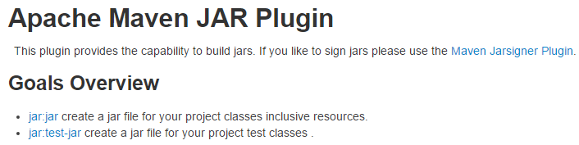
Maven plugins
<plugin>
<groupId> org.apache.maven.plugins </groupId>
<artifactId> maven-jar-plugin </artifactId>
<version> 2.5 </version>
<configuration>
…
</configuration>
</plugin>

Slide 43
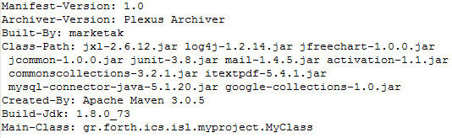
Maven Plugins
Make a jar executable
<plugin>
<groupId> org.apache.maven.plugins </groupId>
<artifactId> maven-jar-plugin </artifactId>
<version> 2.5 </version>
<configuration>
<archive>
<manifest>
<mainClass> gr.forth.ics.isl.MyExample </mainClass>
<addClasspath> true </addClasspath>
</manifest>
</archive>
</configuration>
</plugin>

Slide 44
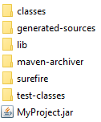
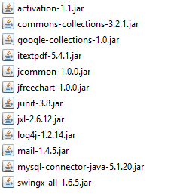
Maven Plugins
Copy dependent libs under target
<plugin>
<groupId> org.apache.maven.plugins </groupId>
<artifactId> maven-dependency-plugin </artifactId>
<version> 2.9 </version>
<executions>
<execution>
<phase> package </phase>
<goals>
<goal> copy-dependencies </goal>
</goals>
<configuration>
<outputDirectory>
${project.build.directory}/lib
</outputDirectory>
</configuration>
</execution>
</executions>
</plugin>

Slide 45
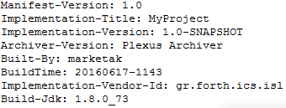
Maven Plugins
Add information in the manifest of a jar
<plugin>
<groupId> org.apache.maven.plugins </groupId>
<artifactId> maven-jar-plugin </artifactId>
<version> 2.5 </version>
<configuration>
<archive>
<manifest>
addDefaultImplementationEntries>true</addDefaultImplementationEntries>
</manifest>
<manifestEntries>
<BuildTime>
${maven.build.timestamp}
</BuildTime>
</manifestEntries>
</archive>
</configuration>
</plugin>

Slide 46
Maven Plugins
Producing dependencies-free artifacts (1/2)
<plugin>
<groupId> org.apache.maven.plugins </groupId>
<artifactId> maven-assembly-plugin </artifactId>
<version> 2.5 </version>
<executions>
<execution>
<phase> package </phase>
<goals>
<goal> single </goal>
</goals>
</execution>
</executions>
…
</plugin>

Slide 47

Maven Plugins
Producing dependencies-free artifacts (2/2)
<plugin>
<groupId> org.apache.maven.plugins </groupId>
<artifactId> maven-assembly-plugin </artifactId>
<version> 2.5 </version>
…
<configuration>
<archive>
<manifest>
<mainClass> gr.forth.ics.isl.myproject.MyClass </mainClass>
<addClasspath> true </addClasspath>
</manifest>
</archive>
<descriptorRefs>
<descriptorRef> jar-without-deps <descriptorRef>
<descriptorRefs>
</configuration>
</plugin>

Slide 48
Maven Plugins
Creating assemblies
<plugin>
<groupId> org.apache.maven.plugins </groupId>
<artifactId> maven-assembly-plugin </artifactId>
<version> 2.5 </version>
…
<configuration>
<descriptor>
src/assembly/dep.xml
<descriptor>
</configuration>
<executions>
…
<executions>
</plugin>
<assembly>
<formats>
<format> zip </format>
<formats>
<filesets>
<fileset> … </fileset>
<filesets>
</assembly>

Slide 49
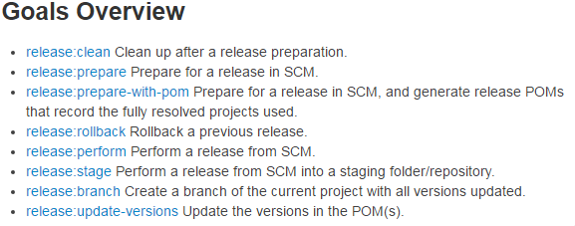
Maven Plugins
Maven Release Plugin

Slide 50
Maven multi-modules
A project-aggregation mechanism
Collects the available modules (projects)
Sorts the into the correct build order (resolve any dependencies)
Builds the project in the correct order
MyProject
<project>
…
<modules>
<module> WebProjA </module>
<module> ProjLibA </module>
<module> ProjLibB </module>
</modules>
…
</project>
WebProjA.war
ProjLibA.jar
ProjLibB.jar

Slide 51
Maven – Project Creation
Manually
Using Maven archetype plugins
Using an IDE

Slide 52
Maven – Project Creation – manual
The user has to create
The folder structure
The POM
This process is error-prone

Slide 53
Maven – Project Creation – archetype
Maven offers the archetype plugins to create projects.
mvn archetype:generate -DgroupId=gr.forth.ics.isl
-DartifactId=MyProject
-DarchetypeArtifactId=maven-archetype-quickstart
-DinteractiveMode=false
Creates an (empty) maven project
With a proper folder structure
With a valid POM

Slide 54
Maven – Project Creation – IDE
Popular IDEs already support Maven
Netbeans and Intelli IDEA
Functionalities are integrated with the application
Eclipse
Through the M2Eclipse plugin

Slide 55
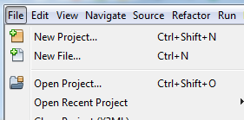
Maven – Project Creation – IDE
The NetBeans use case
Create a new Project (File → New Project)

Slide 56
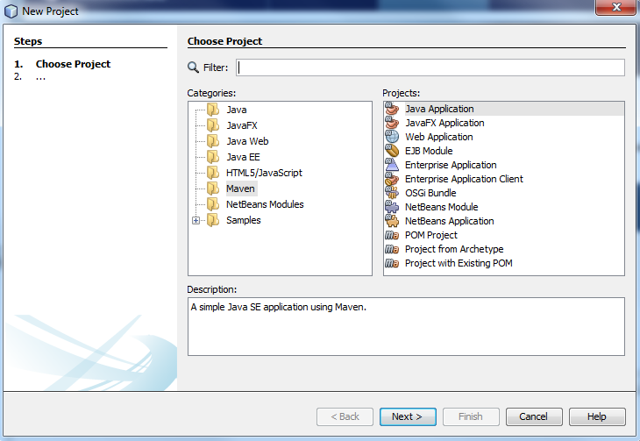
Maven – Project Creation – IDE
Select Maven → Java Application

Slide 57
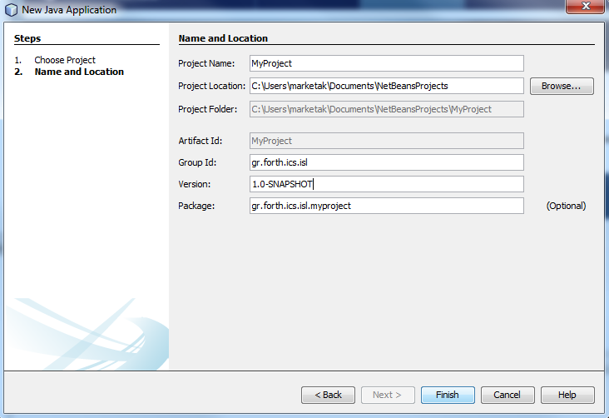
Maven – Project Creation – IDE
Add the POM details

Slide 58
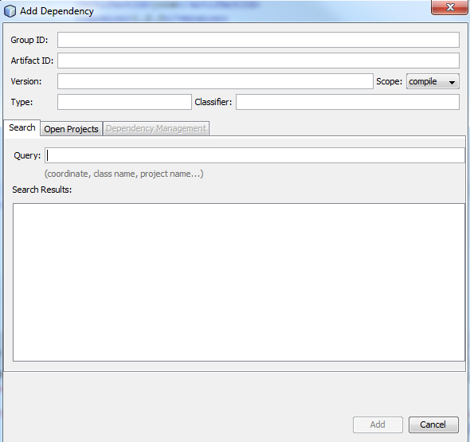
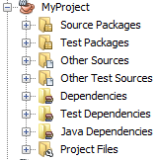
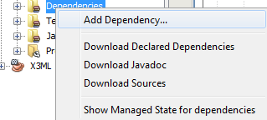
Maven – IDE integration

Slide 59
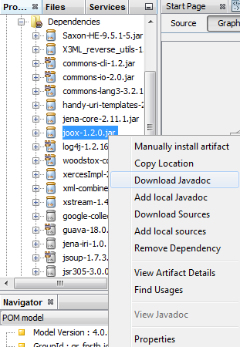
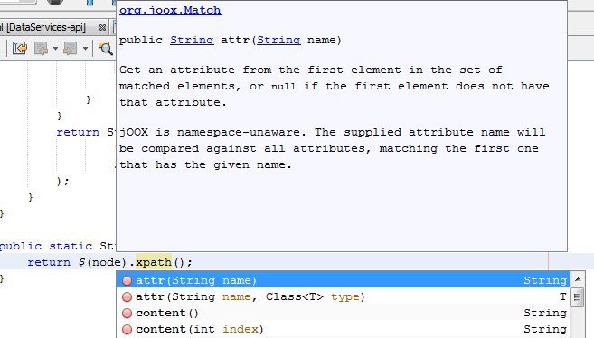
Maven – IDE integration

Slide 60
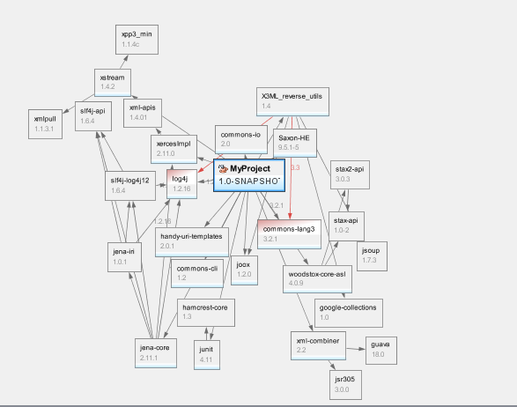
Maven – IDE integration
See the (transitive) dependency graph

Slide 61
Maven – pros and cons
+
Dependency management
Dependencies are downloading automatically
Building/Testing/Publishing are supported
Ensures that a project is working as expected (because of the lifecycle)
Eliminates the risk of runtime exceptions
Reduced duplication
Consistent project structure
Good IDE integration
Easy learning curve

Slide 62
Maven – pros and cons
-
Maven local repository can become quite large
Requires internet connection to download dependencies
Not straight-forward with non-maven dependencies

Slide 63
Maven – Best practices
Always use SNAPSHOTs during development
Before you start developing new things
Avoid using SNAPSHOTs for releases
To ensure the functionality of your artifacts
Always declare versions (especially for plugins)
To avoid surprises
Use (and abuse) modules
Easier to manage and maintain

Slide 64


Slide 65
Gradle
A flexible and general purpose build system
Support the build-by-convention (like in maven but more flexible and configurable)
It supports DSL -Domain Specific Language (based on Groovy)
Multi-project and dependency management support
Support ant tasks and builds
Combines the advantages of popular tools and frameworks
Maven, Ant, Ivy, Groovy

Slide 66
Gradle – Basic features / concepts
Every Gradle build is made up of one or more projects
A project represents what we want to do with Gradle
Jar library
Web application
Zip assembly
Each project is made up of one or more tasks
Compilation
Javadocs generation
Etc.

Slide 67
Gradle – Basic features / concepts
Every Gradle build is made up of one or more projects
A project represents what we want to do with Gradle
Jar library
Web application
Zip assembly
Each project is made up of one or more tasks
Compilation
Javadocs generation
Etc.

Slide 68

Gradle – Basic features / concepts
Based on the build configuration script (build.gradle)
task hello {
doLast {
println 'Hello world!'
}
}

Slide 69

Gradle – Basic features / concepts
task stringOper{
doLast {
String someString = 'MyProject'
println "Welcome to " + someString.toUpperCase()
}
}

Slide 70

Gradle – Basic features / concepts
task count {
doLast{
4.times { print "$it " }
}
}

Slide 71
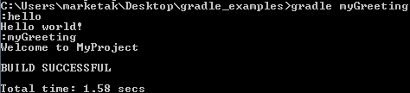
Gradle – Basic features / concepts
task hello {
doLast {
println 'Hello World!'
}
}
task myGreeting(dependsOn: hello) {
doLast{
println "Welcome to MyProject!"
}
}

Slide 72
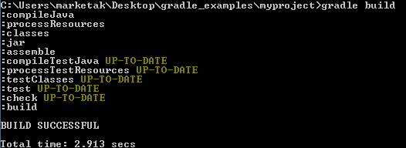
Gradle – Basic features / concepts
Gradle exploits plugins for configuring projects
i.e. Java plugin
Just define the following in the build file
apply plugin: 'java'
It adds the appropriate tasks for supporting the lifecycle of Java projects
Gradle expects a maven-like folder structure

Slide 73
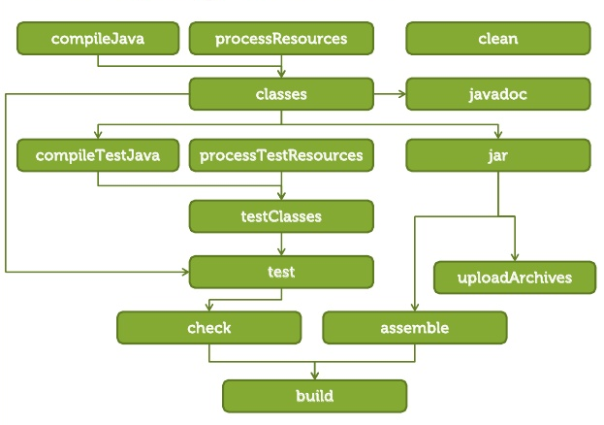
Gradle – Basic features / concepts
JAVA plugin tasks

Slide 74
Gradle – Basic features / concepts
Using external repositories
repositories {
mavenCentral()
}
Declaring dependencies
dependencies {
compile group:'commons-collections', name:'commons-collections', version: '3.2‘
}

Slide 75
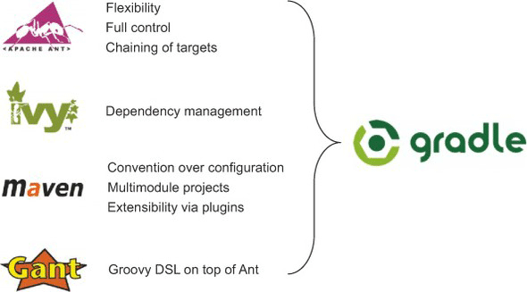
Gradle vs others

Slide 76
Gradle vs others
+
Build files (build.gradle)
Fully configurable and flexible
Supports tasks exclusion
Supports task-injection at any level
Custom dependency scopes
Filesystem-based dependencies
Support and maintenance (by Google) for building Android applications

Slide 77
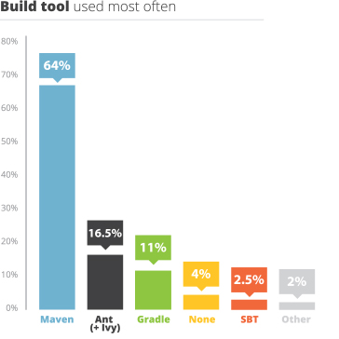
Gradle vs others
-
Build files (build.gradle)
It is still buggy
Poor integration with IDEs
Requires learning and familiarization to fully exploit it
Poor exploitation from the market
Oct, 2014

Slide 78
References and Links
http://maven.apache.org/
http://www.javatpoint.com/maven-tutorial
http://www.tutorialspoint.com/maven/
http://gradle.org/
http://www.groovy-lang.org/
http://www.tutorialspoint.com/gradle

Slide 79


